Slide 1


Innerlayer Copper Balancing Phase 2
Team Leader:
Asa Guest, IBM
Facilitator:
Karl Sauter
Implementation
Host: Japan Pure Chemical
May 22, 2025
© HDP User Group International

Slide 2
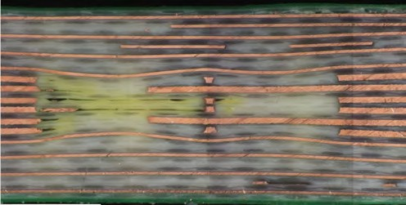
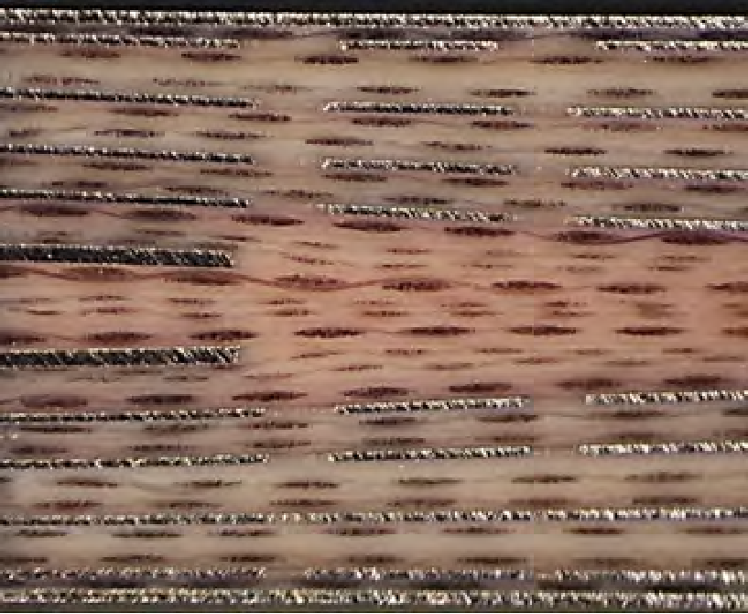
Background
Localized areas of Innerlayer Copper Imbalance can result in localized innerlayer core deformation.
Increasing Zo variation across high-speed channels
Increases risk of Lamination voids, micro fracturing under large components
Increased warpage & non-linear scaling
Increases uncertainty/variation of layer z-axis location:
Increasing backdrill stub variation
Increased surface topology variations
Extent of Core deformation & Sensitivity to Inner Layer Copper Imbalance is an interaction between material selection and stackup.
Project Phase 1: Quantified sensitivity of void size and density stacking on core deformation, Surface topography for assembly, and recommended design approaches focused on Low Loss and Ultra Low-Loss laminates.
05/22/2025

Slide 3
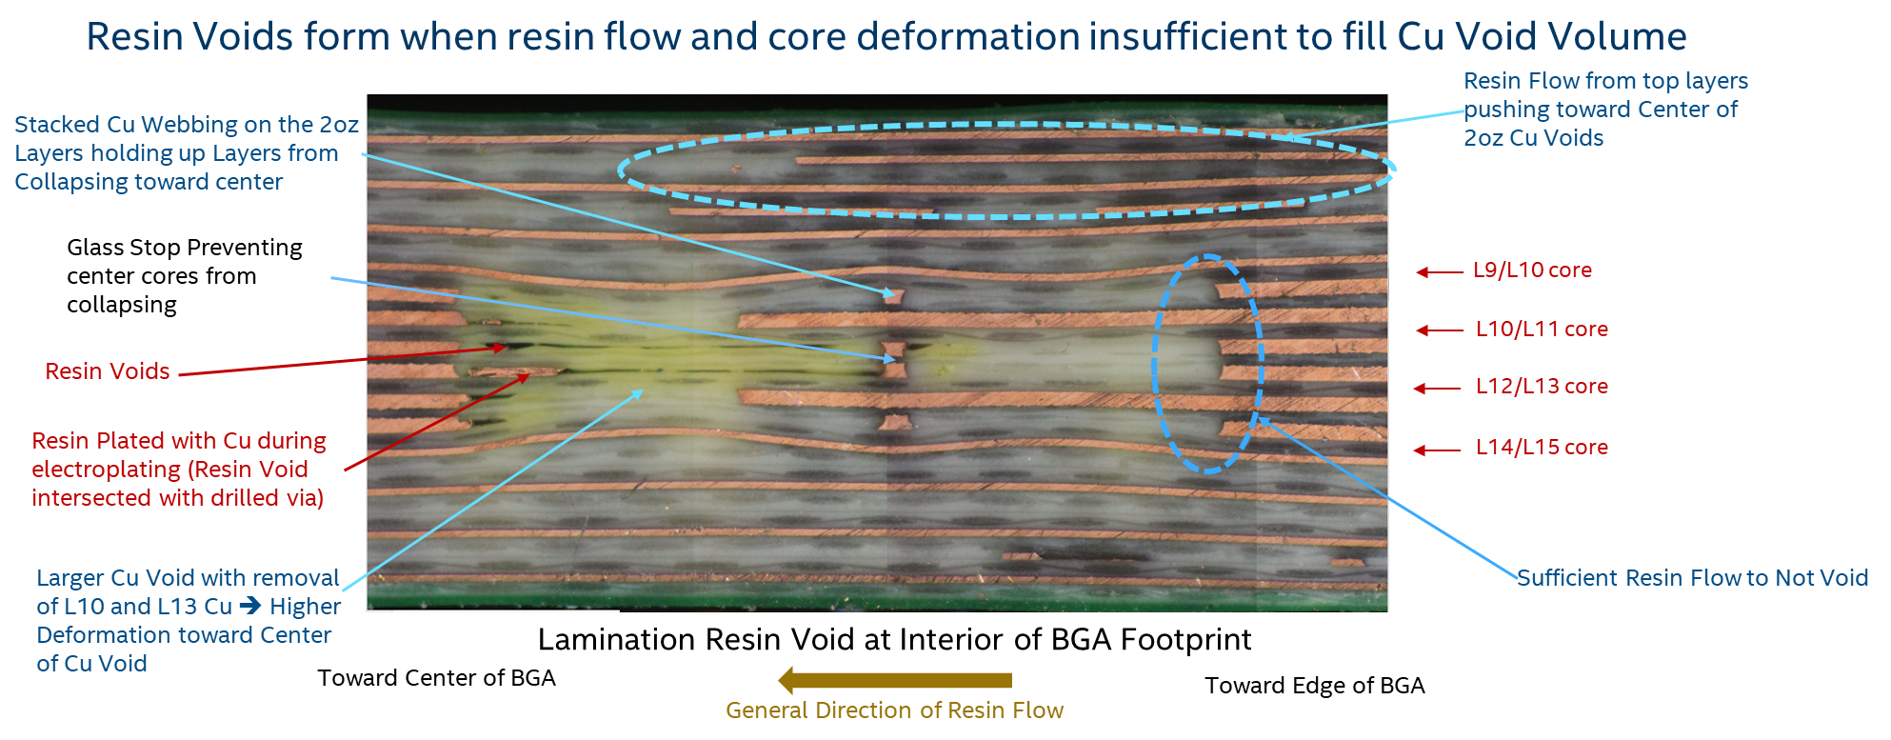
Phase 2 Motivation: Core Deformation and Insufficient Resin Fill
5/22/2025

Slide 4
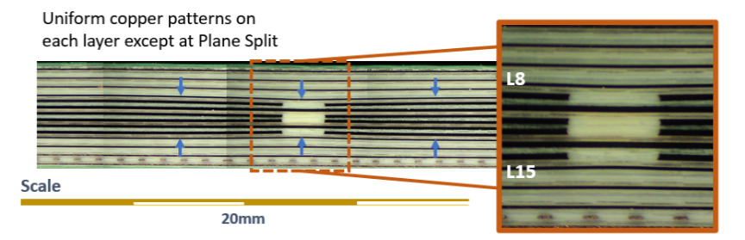
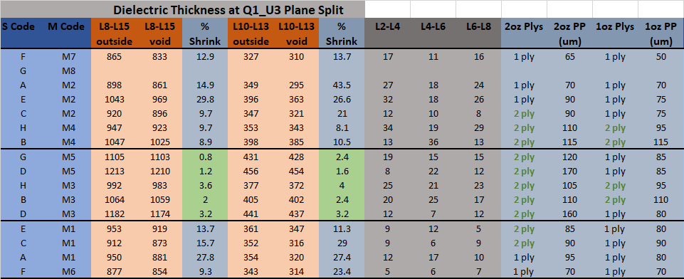
Phase 2 Motivation : Stackup and Material Selection
Preventing core deformation requires filling voids on adjacent layers at same rate
When copper void volume is different between adjacent layers ➔ prepreg thickness needs to be selected so that void fill rates are similar (most prominent with change in copper thickness)
Post Lamination
Higher flow materials
High deformation with high flow
Minimal deformation with either lower or higher flow when prepreg thickness match void volume ratio
Lower flow materials
High deformation with low flow
5/22/2025

Slide 5
Project Deliverables Phase 2
CAD translator utility, a 3D translation rotation best fit (TRBF) algorithm, that will provide analysis of local copper distribution to identify risk areas for:
Core deformation and backdrill stub variation (coplanarity)
Surface topography variations
Local areas of glass stop
Additional validation of model for mitigation of using different process flows (sub lam sequence and stack-up changes).
Phase 1 was a "hammer test" with respect to design
Quantify extent that construction stack-up can overcome unbalanced designs
5/22/2025
5

Slide 6
Member Benefits
OEM & Designers: Improve copper fill design guidelines;
Minimize impedance variations not captured in Zo coupons
Minimize backdrill stub length variations under large BGAs
Mitigate core deformation and surface deformation from copper distributions, also surface deformation and dynamic warpage
Understand how laminate material properties can affect the design analysis for local copper balancing mitigating core deformation
Reduce design costs and time to achieve more consistent electrical and topographical performance
ODMs: Understand the impact of copper distributions on dynamic warpage and boot issues (impedance variations, backdrill stubs)
5/22/2025

Slide 7
Member Benefits - Continued
PCB Fabricators: Identify potential risk areas for designers and understand to what extent resin material flow properties can modulate core deformation issues due to copper distributions.
Laminate Suppliers: Understand how resin flow properties, copper distributions, and stack-up parameters can impact core deformation.
Additional validation of the coplanarity and core deformation mitigation for sub lam sequence and stackup optimization. This will assure copper fill design rules are correct.
05/22/2025

Slide 8
Phase 2 Model Assumptions/Disclaimers
Blurring algorithms are used as rough approximations to capture Cu density
Current algorithm assumes uniform ‘resin’ flow (kernel size is constant)
Meant to supplement other methods
DFX
Manufacturing experience
Etc.

Slide 9
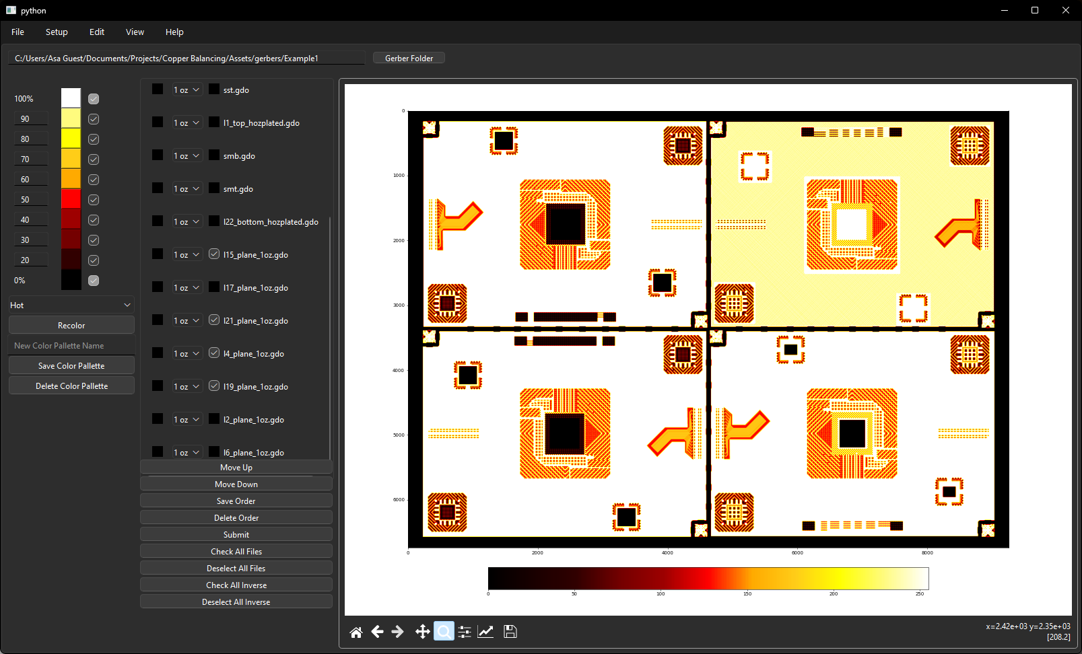
Phase 2 CAD Translator

Slide 10
Phase 2 Plan
Laminate Layers 9-14
1-8 and 15-21
Goal 1 – Verify process alternative process steps improve coplanarity
Quantify the difference
Goal 2 – Qualitatively analyze build data and simulation data for tool verification of risk areas
Match Color Gradients to coplanarity/risk regions
Rolling Average pixel count -> laminate material
Need a TRBF algorithm to do analysis quantitatively
Supplier | Laminate Preferred | Contact
GCE (Site Undetermined) |  | Joe Beers
Victory Giant |  | Dana Korf
ACCL |  | Penny Lien
WUS |  | Greg Link
SCC |  | Sean Shi
TTM-DMC? |  | Todd/Ashley (Tent.)
TTM-FG? |  | Todd/Ashley (Tent.) John Konrad

Slide 11
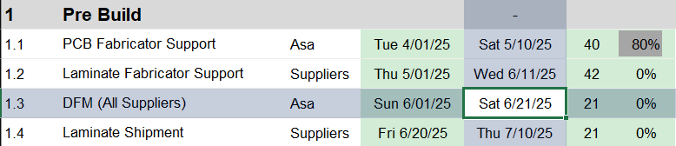
Phase 2 Plan, Cont.
PCB Fabricators
Material Selection
Test Vehicle Build Plan
Fabrication Notes
DFM

Slide 12
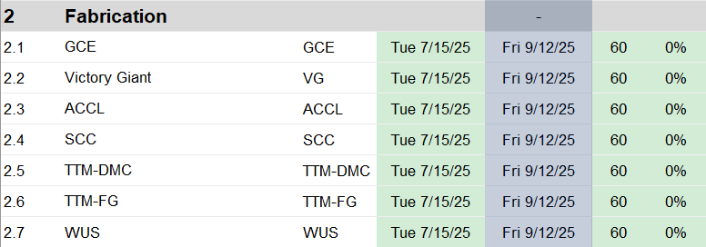
Phase 2 Plan, Cont.
Laminate inner 2 oz cores (take coplanarity measurements)
Laminate 1 oz cores
Minimum of two lots (process to panel plate)
Segment panel into 4 quadrants and route x-section areas

Slide 13
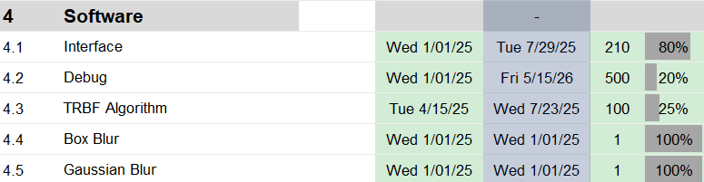
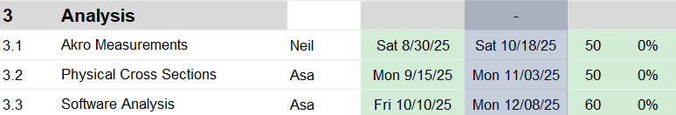
Phase 2 Analysis
Develop TRBF Algorithm to compare modeled to measured data
Measure Flatness across 4 quadrants using phase 1 params
Compare results with phase 1 matching laminate types
X-Section same areas as Phase 1 analysis
Thickness measurements
Void analyses

Slide 14
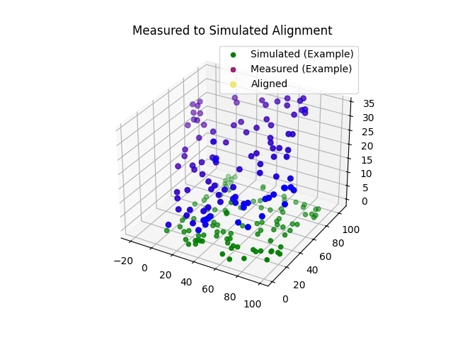
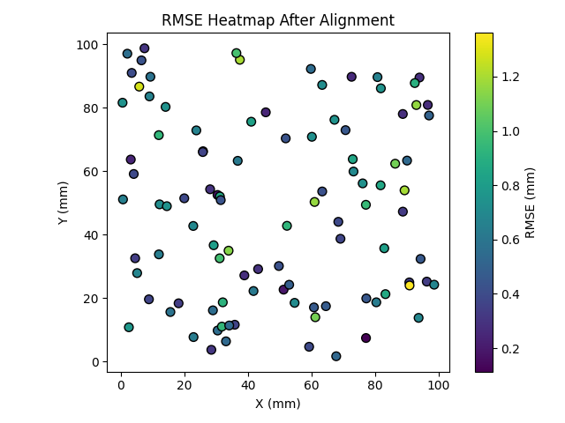
Phase 2 Analysis
Propose to use Single Value Decomposition
Algorithm is complete for point clouds of the same size
Need to develop algorithm to match different sized arrays
R² per axis: X=0.9998, Y=0.9998
Mean RMSE: 0.6127

Slide 15
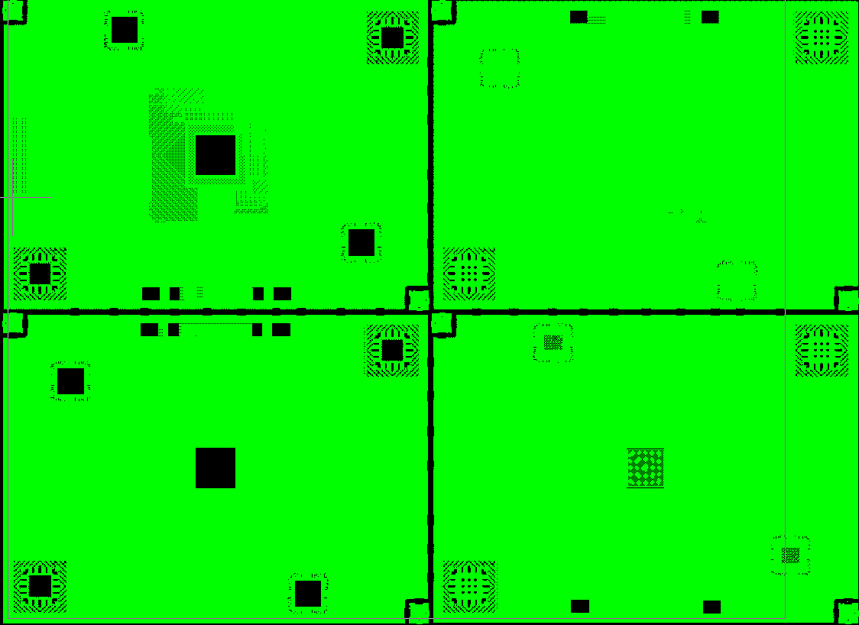
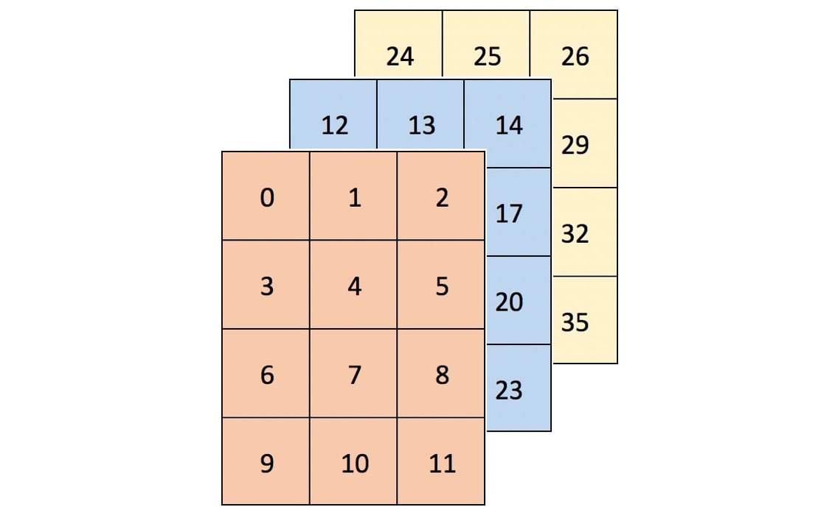
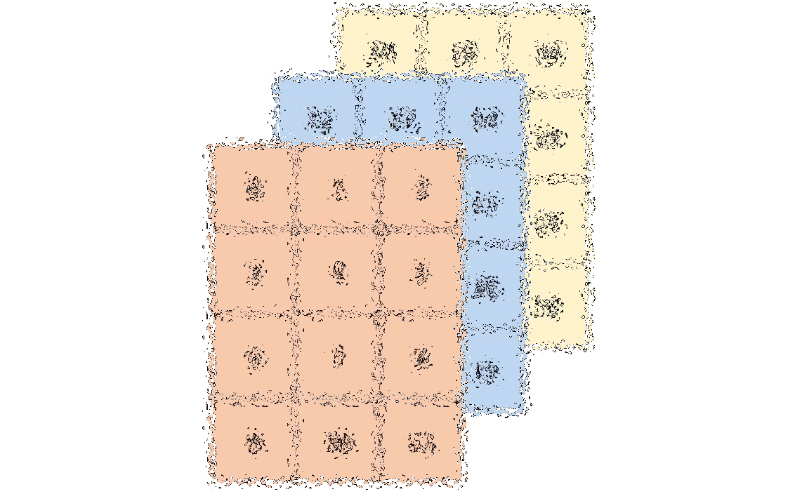
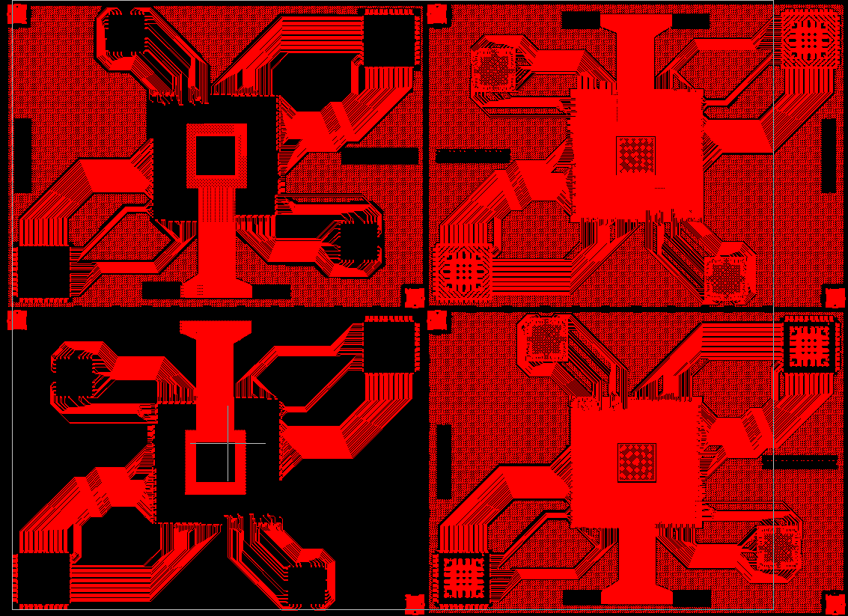
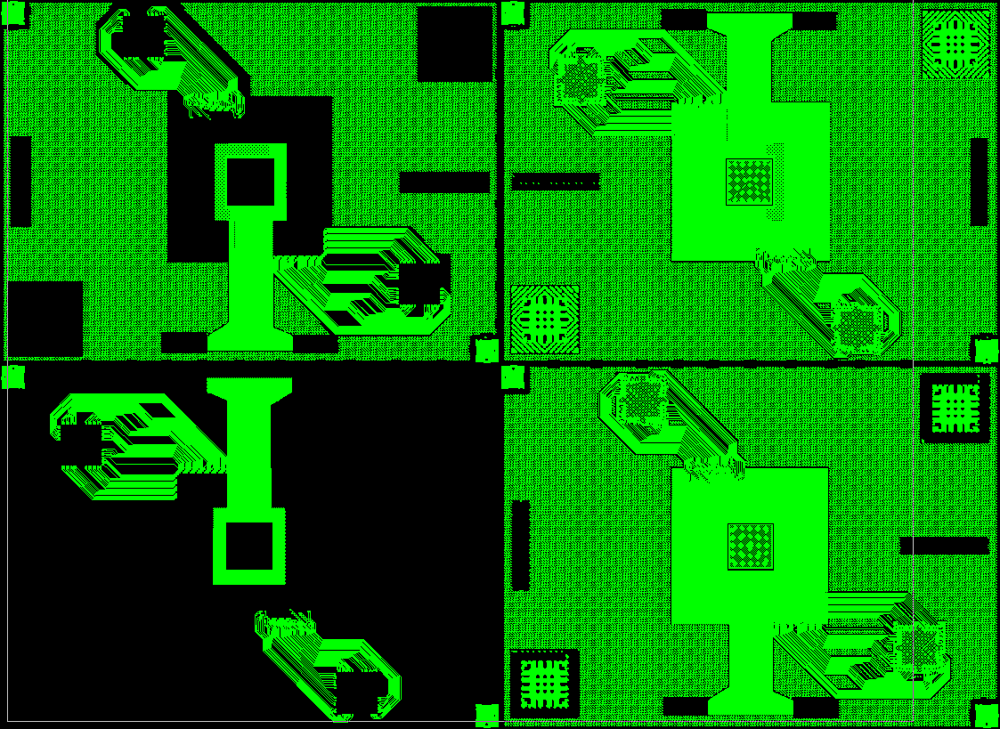
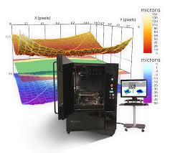
Process Flow
L2
L3
L(N-1)
5280x5280
2000x2000
2000x2000

Slide 16
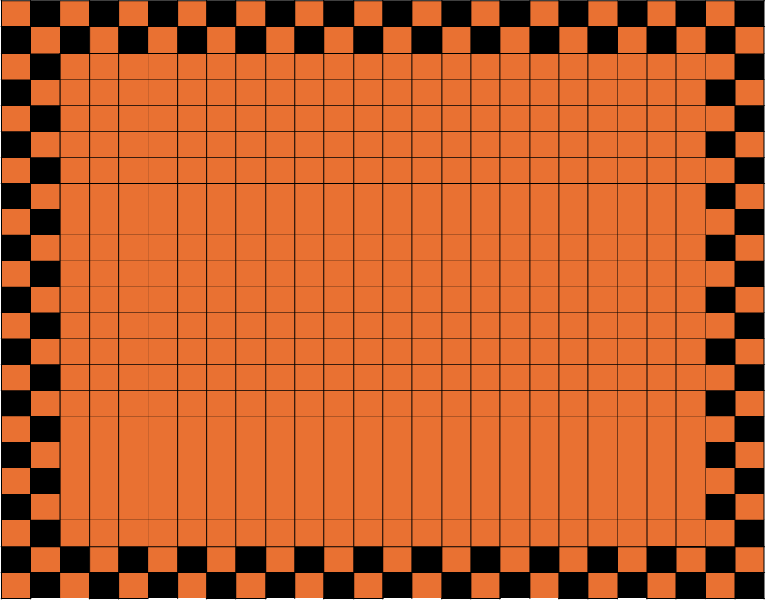
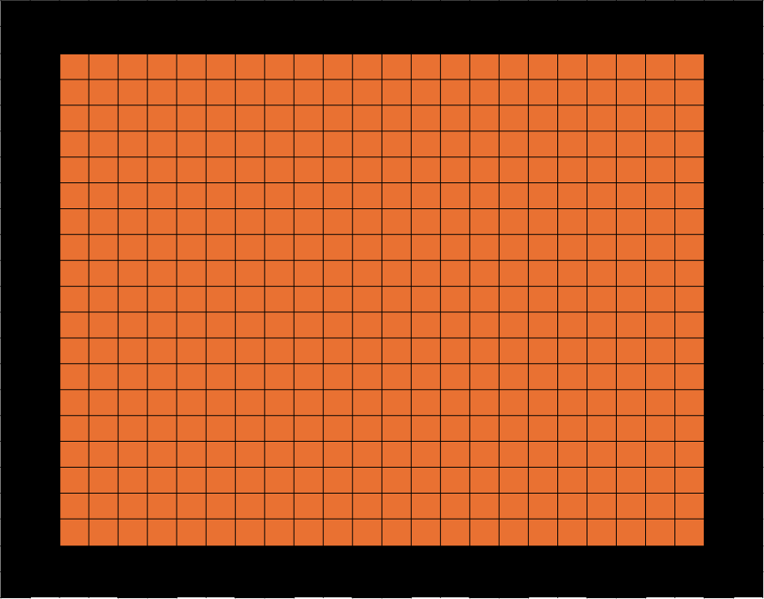
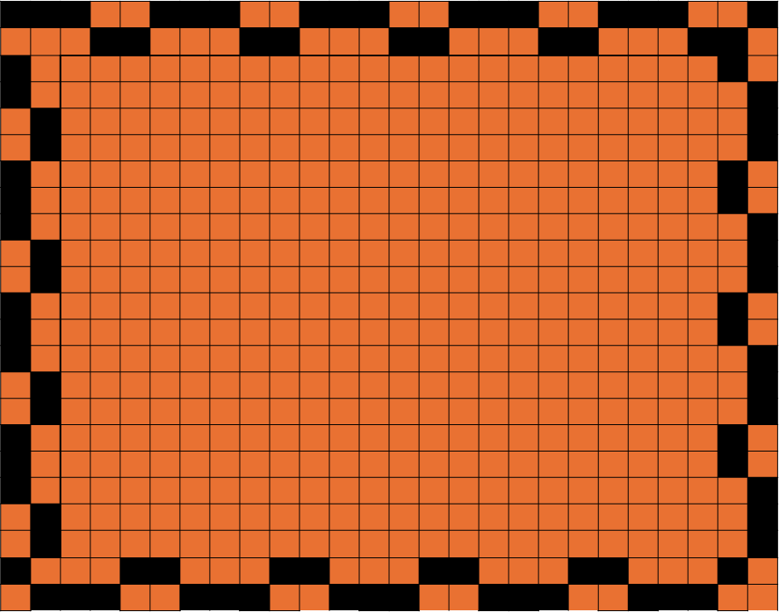
Thieving Updates
For non-manufacturing gerber data, the option to add thieving to the exterior of the panel must be available
Exploring different methods to add patterns that match the kernel size

Slide 17
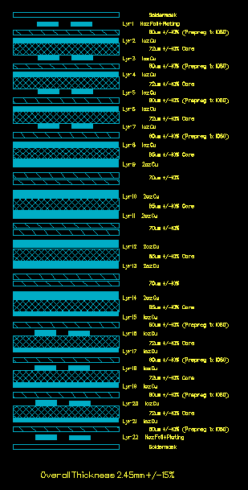
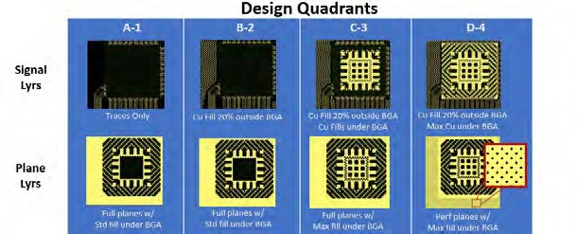
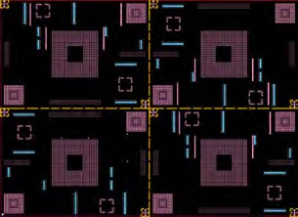
Status: Stackup Modulation; On Hold Until initial modeling of core deformation is more complete
Use same TV from Phase 1 (22 layers, w/ six 2-oz layers)
Ensure any builds use same laminate / PCB fabricator combinations
Build A: Increase prepreg thickness next to 2-oz layers by 100-150%
Change the resin volume to match or exceed fill rate of adjacent 1-oz layers
Goal to minimize or even flip direction of core deformation toward center
Build option B: Fabricate the center 2-oz layers as sublam to decouple 1-oz vs 2-oz deformation.
Build option C: Hybrid construction using higher flow materials at center 2-oz
Analysis of surface topography and core deformation same as Phase 1
Builds only require fabrication through panel plate
5/22/2025

Slide 18
Project Flow Chart -
Stackup Modulation of Core Deformation
Supplier 1 | Lower Flow Ultra Low Loss Laminate system Thick Prepreg @ 2oz lyrs 5 panels
Supplier 2
Supplier A | Lower Flow Ultra Low Loss Laminate system Hybrid 5 panels
Supplier B
Supplier C | Lower Flow Ultra Low Loss Laminate system Phase1 stackup w/ sublam 5 panels
Supplier D
Design
(Cmplt)
Fabrication
X-Section – Core Deformation measurements (1-2 panels/mtrl)
Evaluation
Surface Topography (all panel/mtrl)
Data Analysis
Final Report
Analysis Tool Dev
Artwork Dev
Interface Dev
Manual Testing
/ Verification
Deployment
Github Link
Complete

Slide 19
Resources and Schedule
Task | Resource | Planned | Actual
Complete DOE Matrix | All |  | Complete
TV Design ECAD | Intel |  | Complete
PCB Laminate Materials | EMC, Iteq, AGC, TUC | 2025 July
TV Fabrication | TTM, WUS, VGT, SCC, Founder, SME, ACCL | 2025 September
Surface Characterization | Akrometrix | TBD
Microsection Analysis | Intel | 2025 November
Final Report | All | 2026 May
MetAve software dev | Artwork Conversion Inc |  | Complete
MetAve Testing / analysis | IBM | 2025 May
Wrapper Dev | IBM |  | Complete

Slide 20
Team List
IBM - leader
AGC
Akrometrix
Panasonic
Oracle
Nokia
Juniper
WUS
Resonac
VGT
TTM
EMC
ITEQ
TUC
Co-Tech Development
Sanmina
Intel

Slide 21
Thank You
For questions or comments on this presentation,
please email: karls@hdpug.org

Slide 22
Appendix: Algorithm Information

Slide 23
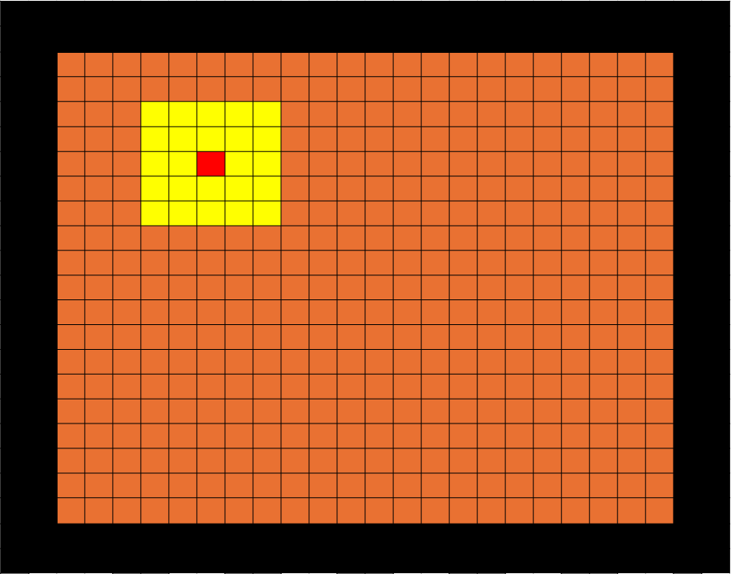
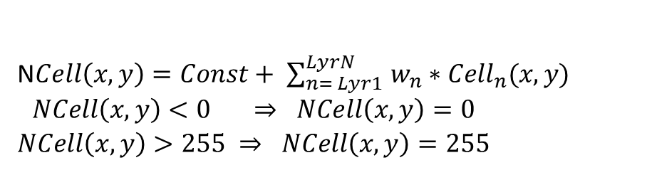
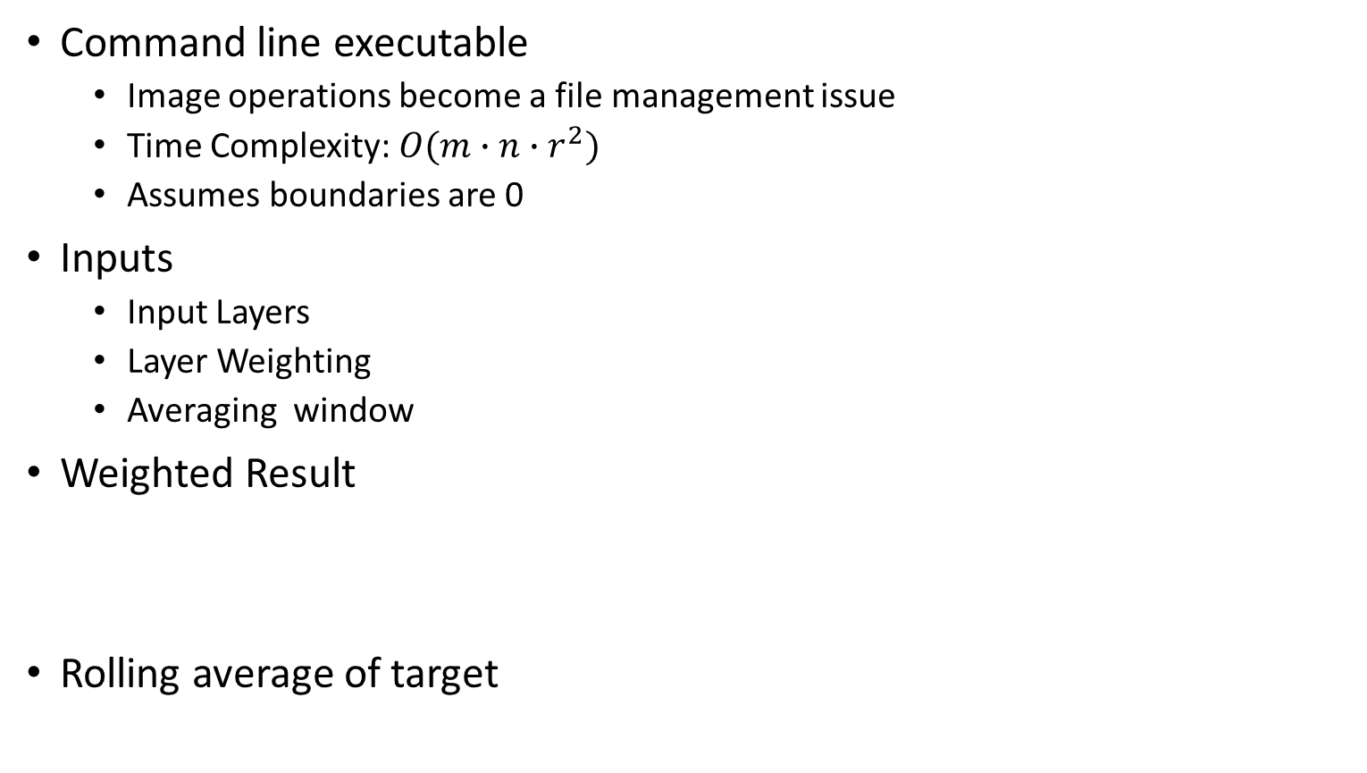
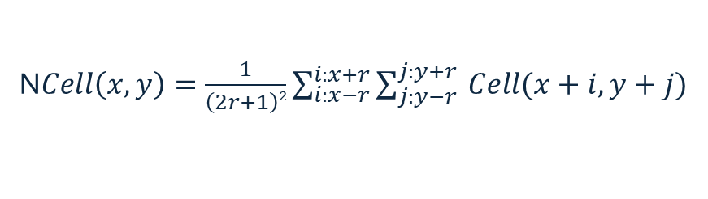
MetAve algorithm (Box Filter)
Command line executable
Image operations become a file management issue
Time Complexity: $O({m∙n∙r}^{2})$
Assumes boundaries are 0
Inputs
Input Layers
Layer Weighting
Averaging window
Weighted Result
Rolling average of target
Ncell(x, y)
N$Cell\left(x,y\right)=Const+ \sum_{n= Lyr1 }^{LyrN}{w_{n}∗{Cell}_{n}(x,y)}$
$$\begin{matrix}NCell\left(x,y\right)<0 ⇒ NCell\left(x,y\right)=0 \\ NCell\left(x,y\right)>255 ⇒ NCell\left(x,y\right)=255\end{matrix}$$
r = 2
N$Cell\left(x,y\right)=\frac{1}{\left(2r+1\right)2}\sum_{i:x−r}^{i:x+r}{\sum_{j:y−r }^{j:y+r}{Cell(x+i,y+j)}}$

Slide 24
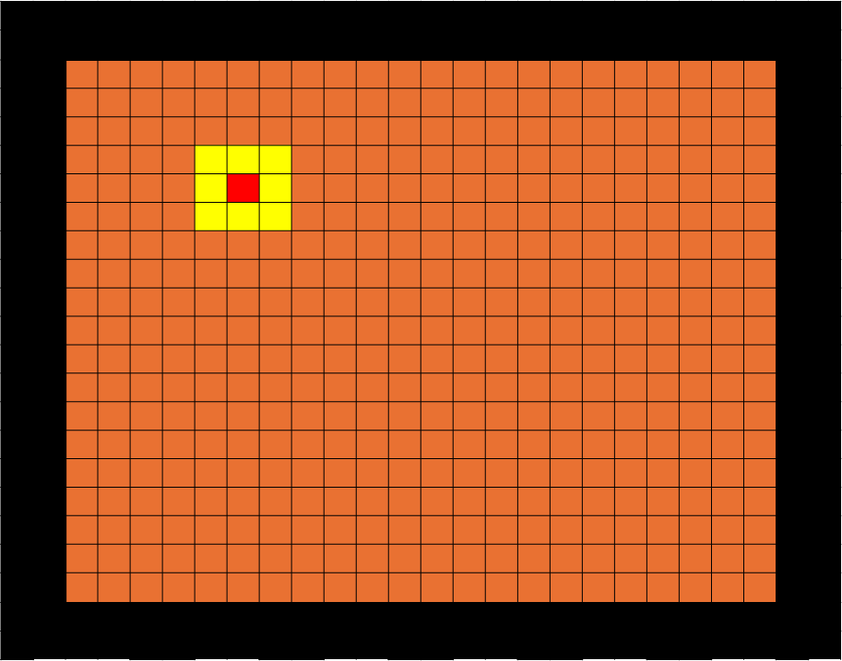
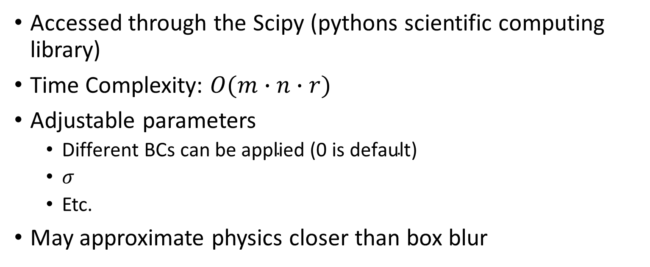
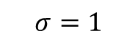
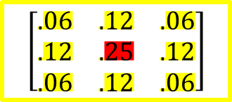
Gaussian Algorithm
Accessed through the Scipy (pythons scientific computing library)
Time Complexity: $O(m∙n∙r)$
Adjustable parameters
$\text{Different} \text{BCs} \text{can} \text{be} \text{applied}\text{ (0 }\text{is} \text{default}\text{)}$
$σ$
Etc.
May approximate physics closer than box blur
$$σ=1$$
$$\left[\begin{matrix}.06 & .12 & .06 \\ .12 & .25 & .12 \\ .06 & .12 & .06\end{matrix}\right]$$

Slide 25
Additional Algorithms To be Added
Median Filter
May require multiple passes
Bilateral Filter
Like Gaussian near strictly copper or strictly ‘prepreg’ regions
Open to adding others

Slide 26
Appendix: Interface Information

Slide 27
Interface Updates
Develop Interface for users to input stack up information/Gerber data
Assign Layer Details (Cu Weight, core/PP thickness)
Pixel size is user defined
Additional Averaging algorithms
Additional Image Options
Pan/Zoom/Rotate
Colorization (User Color Schemes Added)

Slide 28
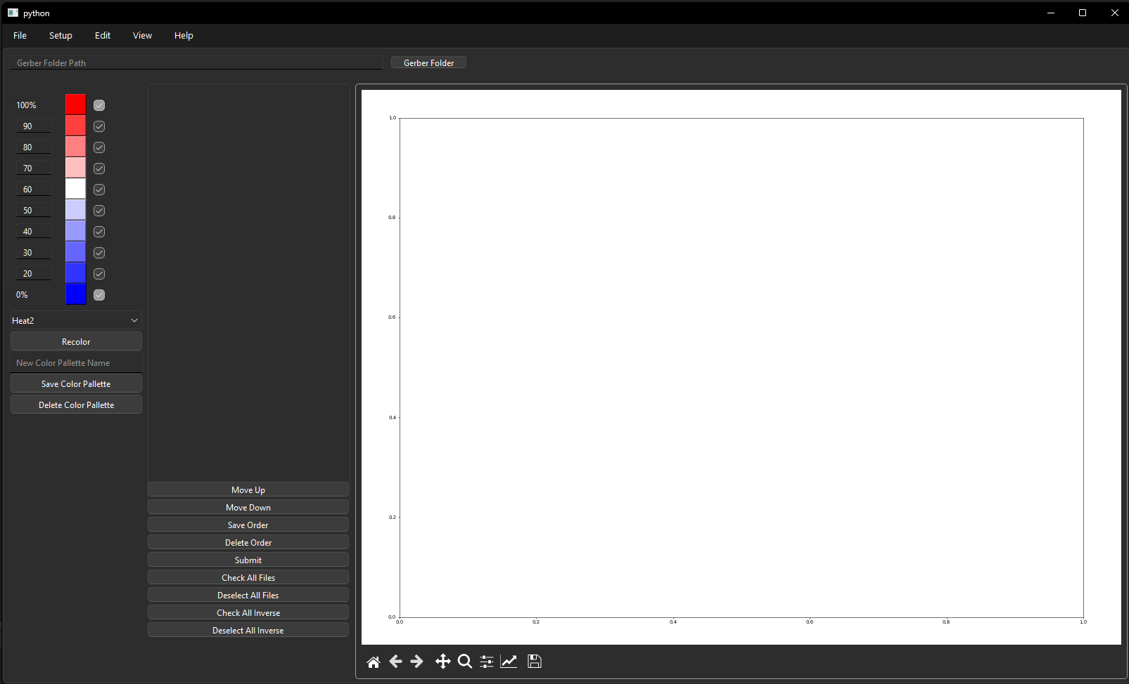
Interface Updates, Cont.
Gerber to Tiff In App
Preset/User defined color mappings
Operations for stack up information from Gerber layers
In App Image View

Slide 29
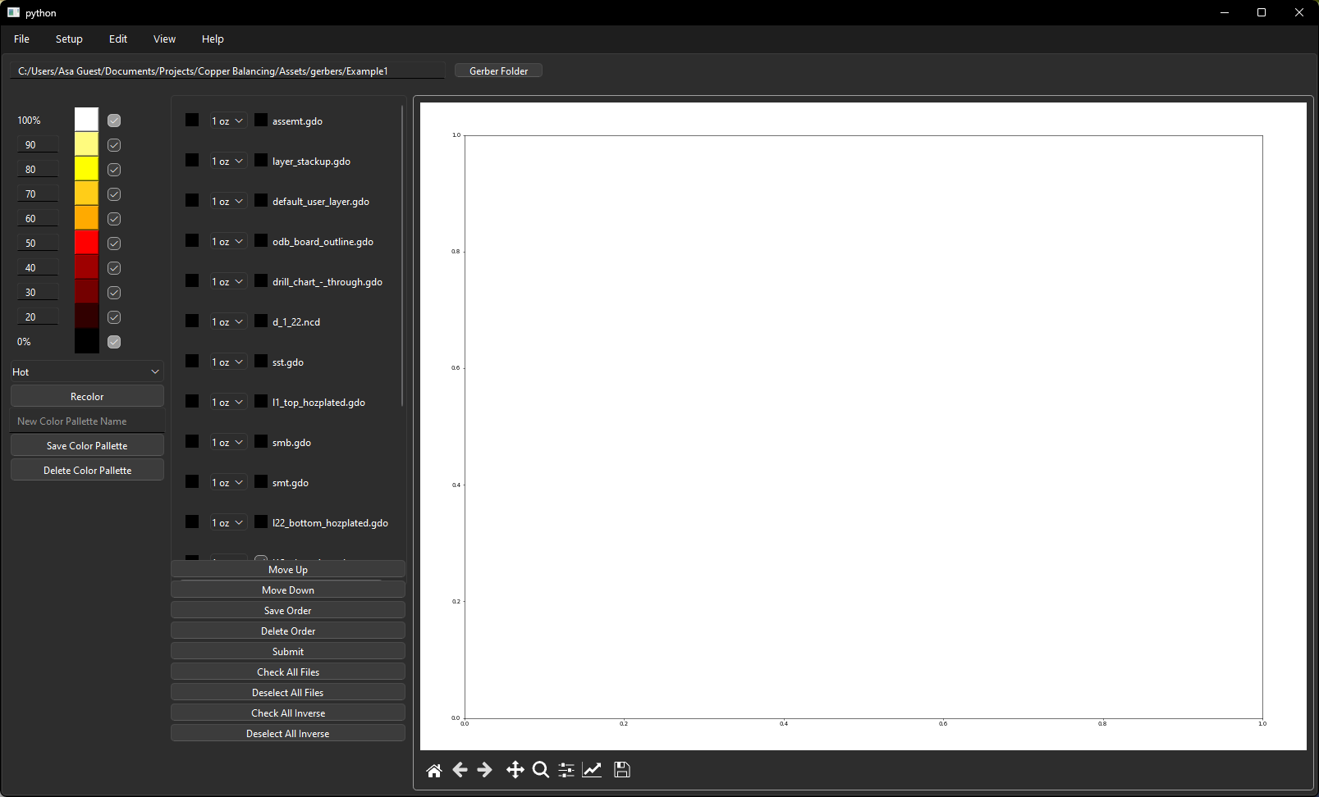
Interface Updates, Cont.
Additional user defined settings
Layer specific modifications
Sub lamination Analysis

Slide 30
Interface Updates, Cont.
Sub lamination Analysis

Slide 31
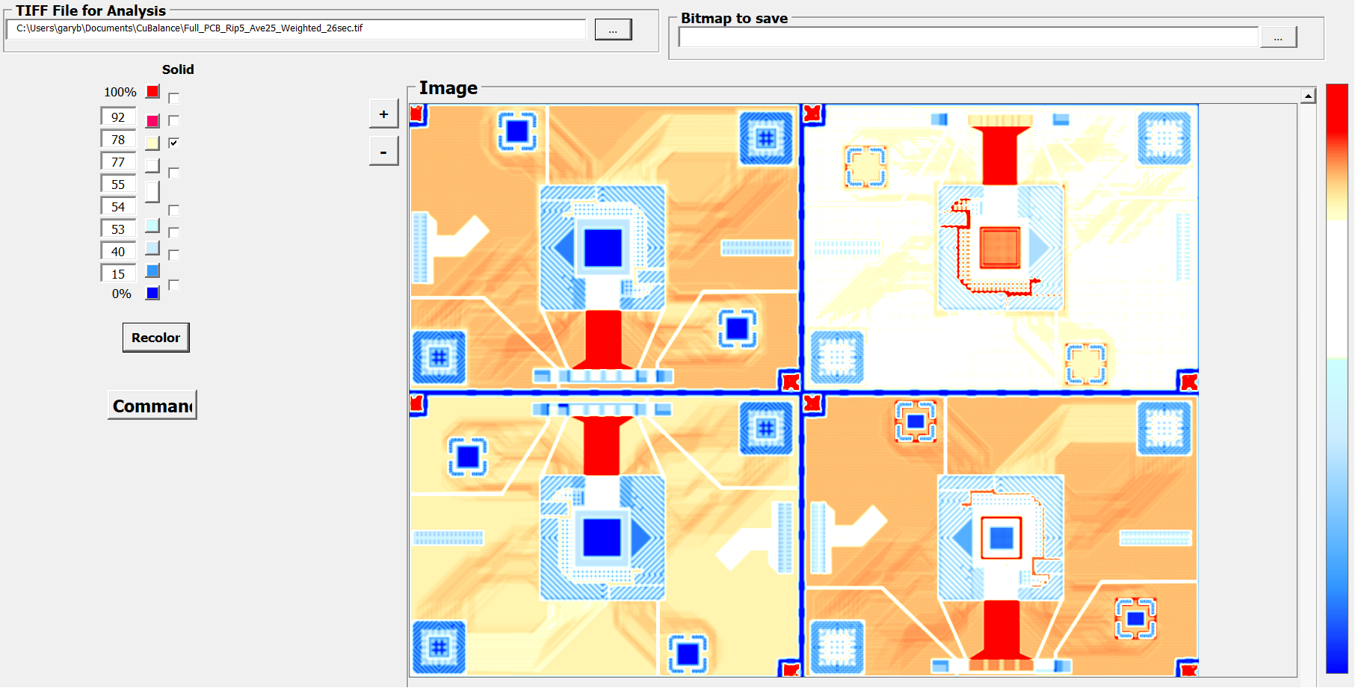
Appendix: Previous Copper Balancing Analysis
API utility from “Artwork Conversion Software, Inc.”
Provide rolling grey scale average over a specified sliding window and window stepping;
Allowing specific layer analysis w.r.t flow distances/properties of resin
Ability to predict where deformation will start, locations of min/max deformation
Provide ability to Add/Subtract multiple grey scale layers using layer weighting
Initial Wrapper created
to utilize API utility and
visualize results
Total Copper
Pixel size: 5x5mil
650um
Visualization of 20% added thieving on signal layers
0um

Slide 32
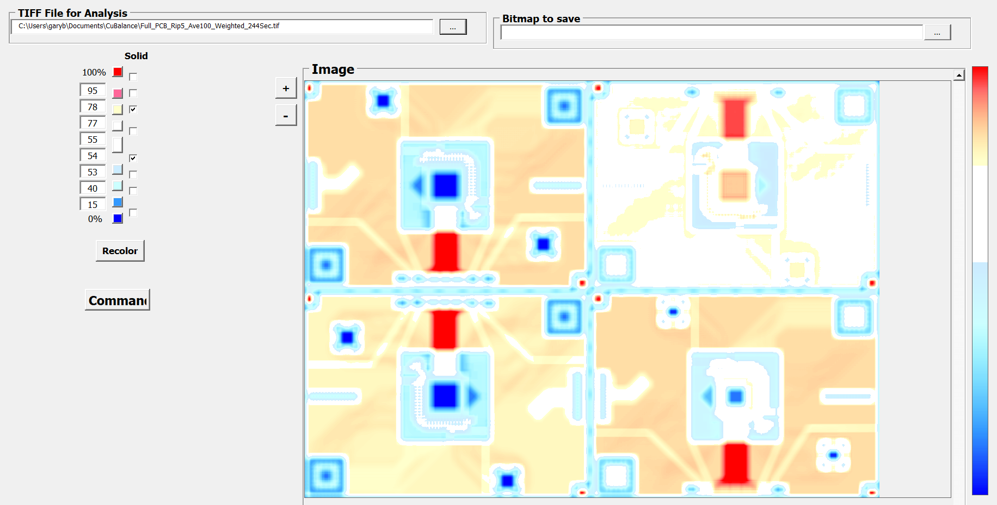
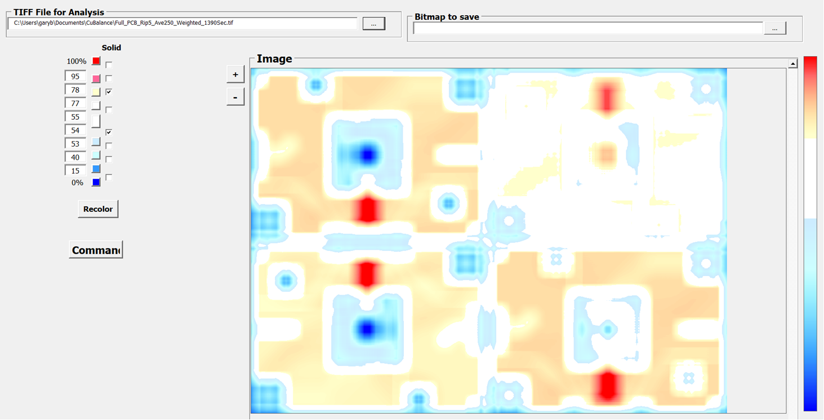
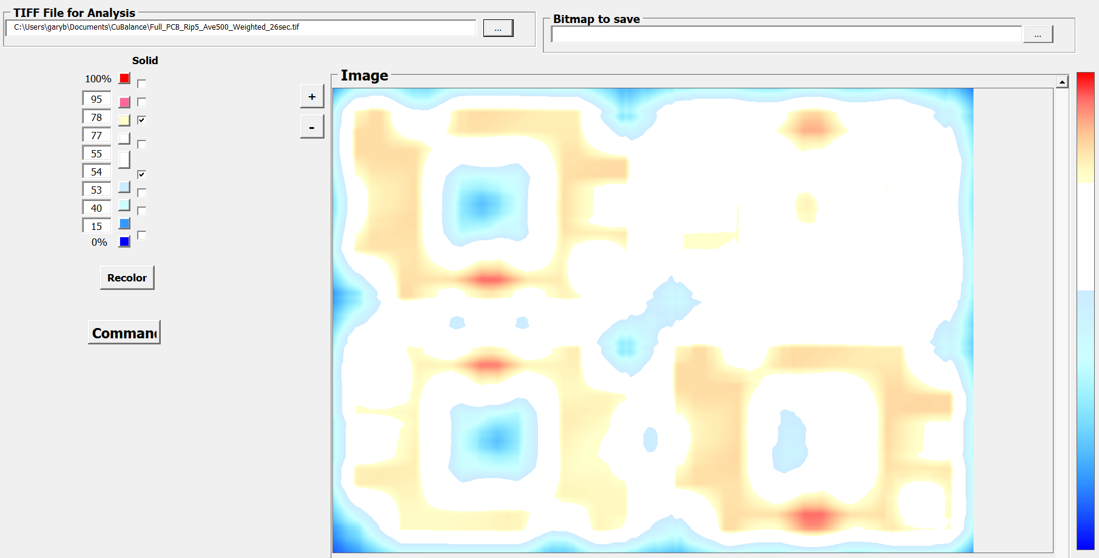
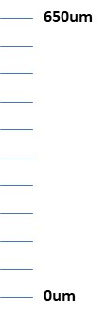
Appendix: Previous Copper Balancing Analysis, Cont.
Example of Rolling Average over different distances
Pixel size at 5x5 mil
Color bands around panel average
0.5 inch
1.25 inch
2.5 inch
Asymmetry of average thickness
Rolling average much better then simple averaging within a set grid w.r.t maintaining a level of local detail otherwise hidden.

Slide 33
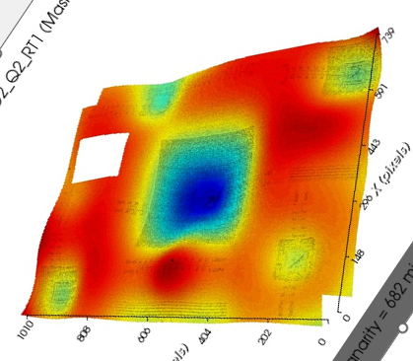
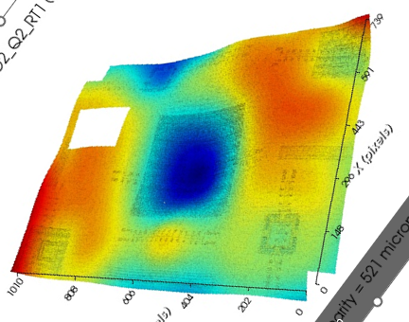
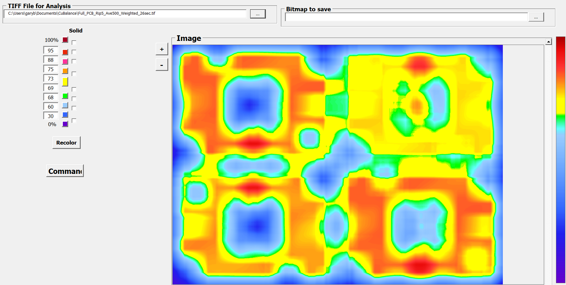
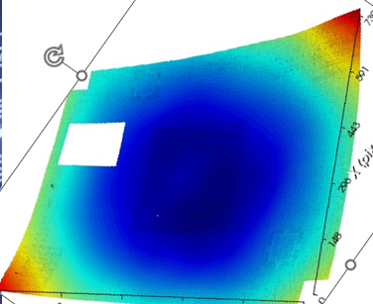
Appendix: Previous Copper Balancing Analysis, Cont.
Panel 2, Mtrl A
Panel 1, Mtrl B
Measured coplanarity variation of Q2
Shadow Moire
650um
Total copper map of Q2 with rolling average
General patterns hold
Basic Shape of High/low areas
Location of Low/High Areas
Except when they don’t:
0um
Panel 1, Mtrl A

Slide 34
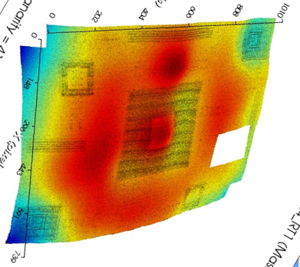
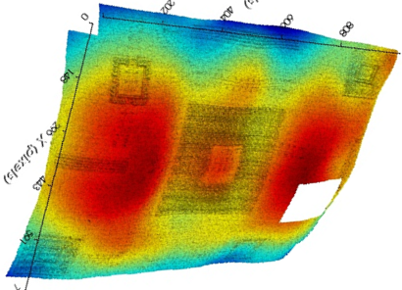
Appendix: Previous Copper Balancing Analysis, Cont.
Panel 2, Mtrl A
Panel 1, Mtrl C
Measured coplanarity variation of Q4
Shadow Moire
650um
General patterns hold
Basic Shape of High/low areas
Location of Low/High Areas
Total copper map of Q4 with rolling average
Total copper map as an indicator of coplanarity will be best when the local thickness variations are the dominate factor affecting coplanarity.
0um

Slide 35


Appendix: Previous Copper Balancing Analysis, Cont.
Changing color threshold mute or accent patterns and gradient detail;
White bands good for mapping areas to address with design
Full bands (jet, nipy_spectral) appear to have better visual correlation with Shadow-Moire measurements
650um
0um

Slide 36
Backup

Slide 37
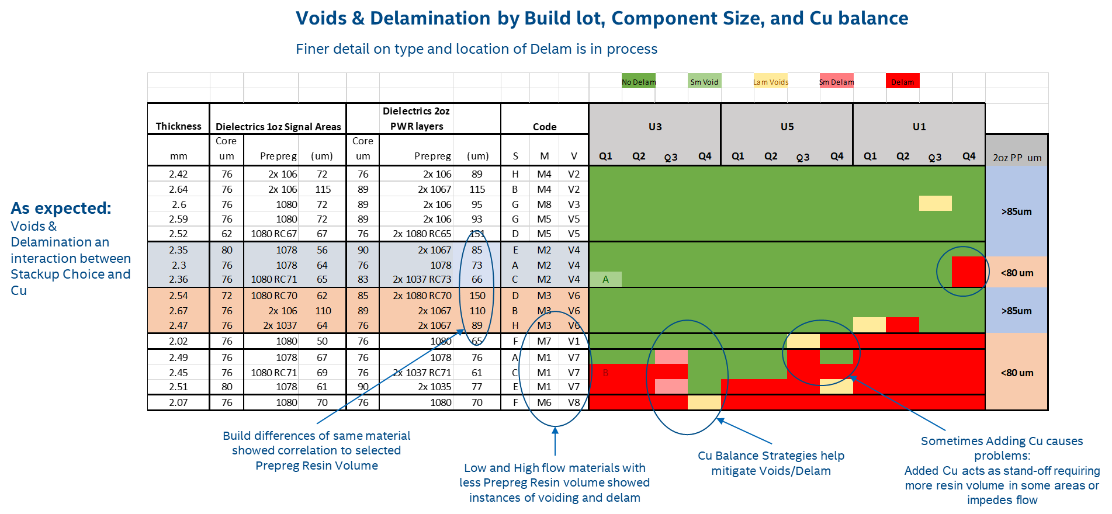
Background (Phase 1) - Additional
Stackup-up (prepreg selection matters for thickness control):
For same material prepreg thickness mattered
5/22/2025

Slide 38
Background (Phase 1) – Additional, Cont.
Supplier | Material A | Material B | Contacts
SME | EM-890K | EM-528 | Brian Drummond, Alex Shen
VGT | EM-890K | EM-528 | George Dudnikov
ACCL | EM-890K | EM-528 | Vincent Yang
TTM | M-8000 | N4000-13EP | Ed Cullens, David Natz
WUS | IT-988GSE | TU-883 | Greg Link
SCC | IT-988GSE | IT-170GT | Vincent Wang
Founder | IT-988GSE | IT-170GT
5/22/2025

Slide 39
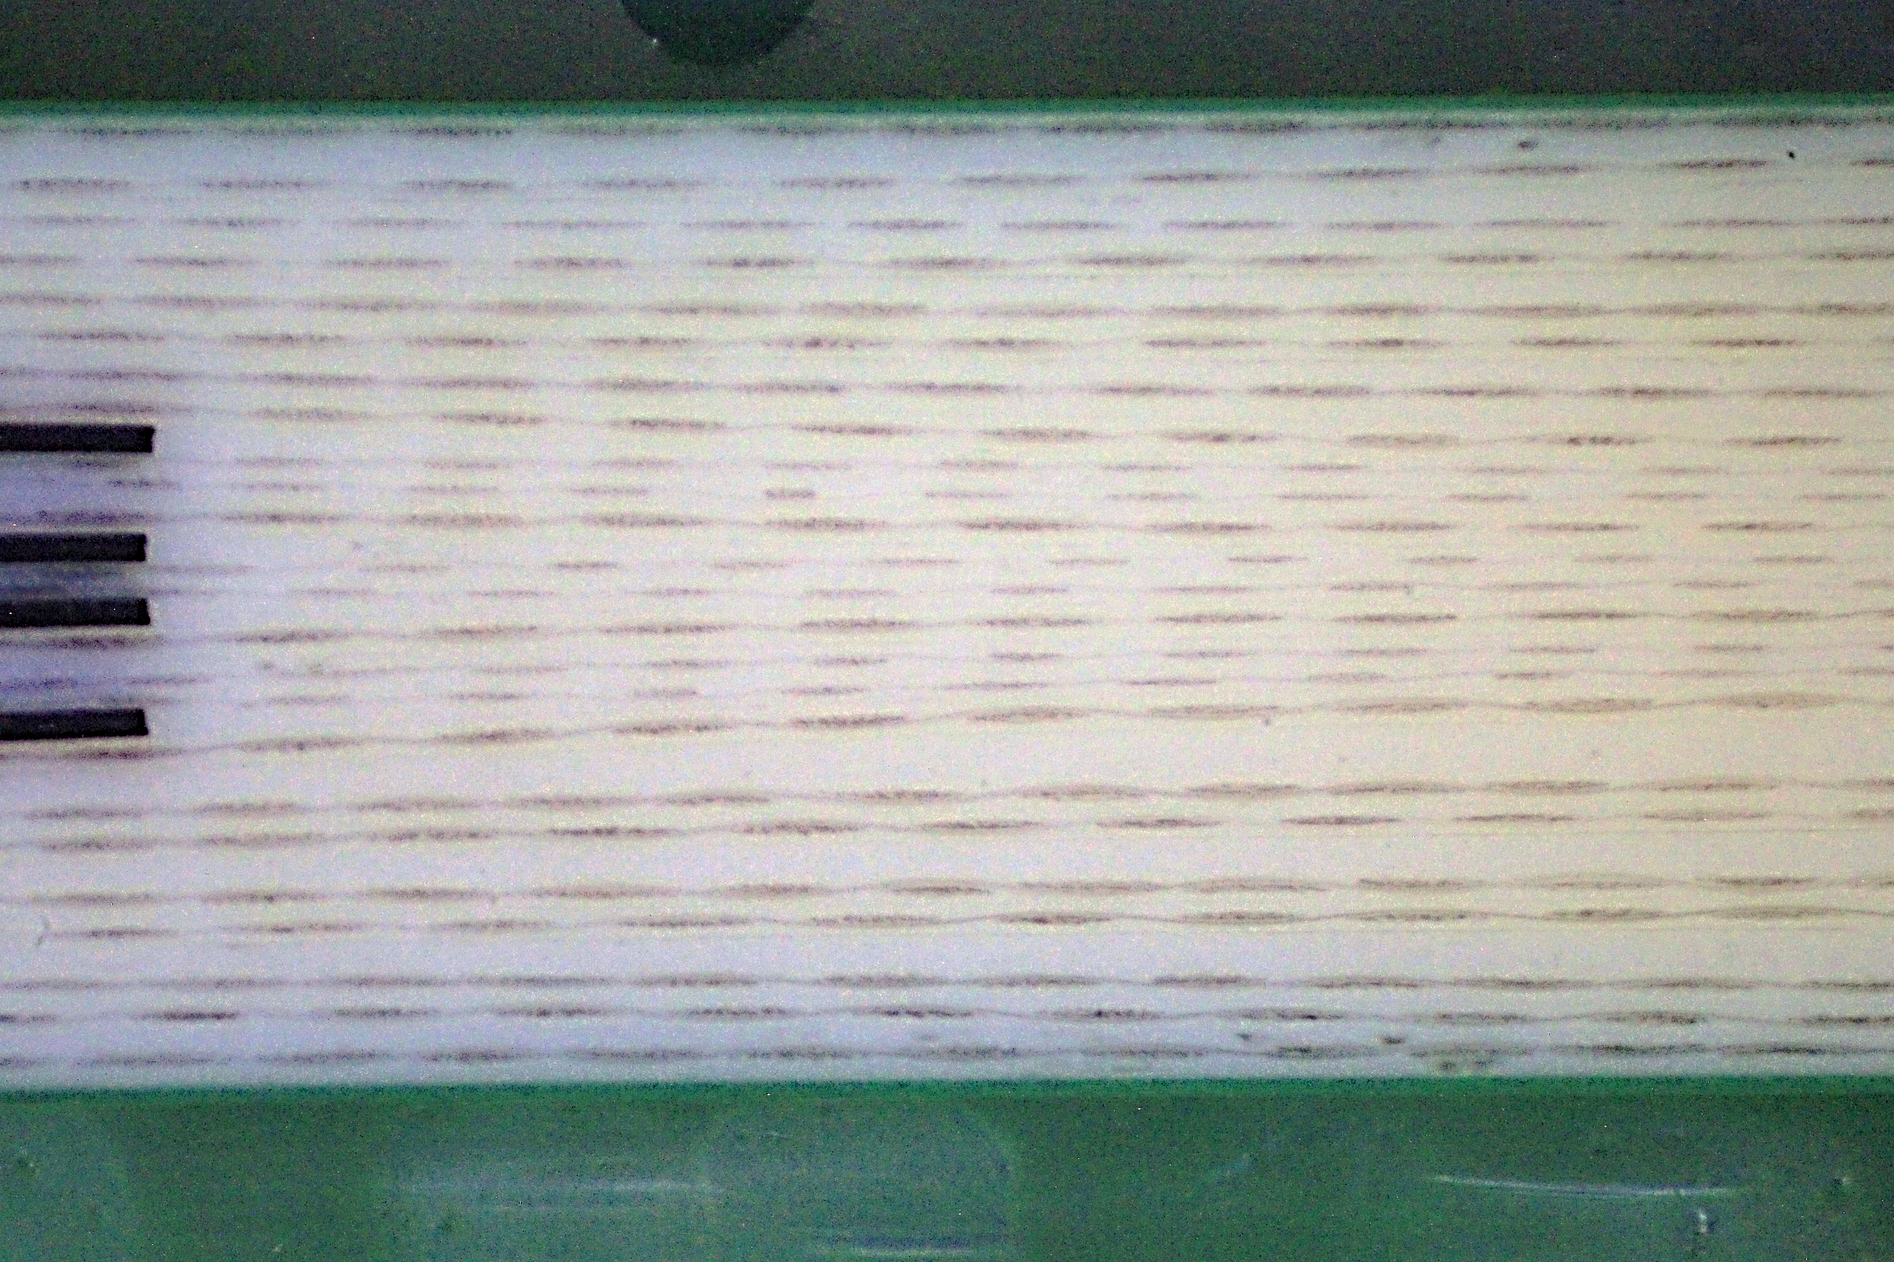
Asymmetry from Symmetric Design & Stackup
Asymmetric location of resin flow and core deformation likely critical to panel-panel variations in coplanarity and backdrill layer location.
Hypothesized to be related to book placement. But, outside of scope/focus of Phase 2
Why more resin here?
Stackup is symmetrical
5/22/2025

